Slide 1
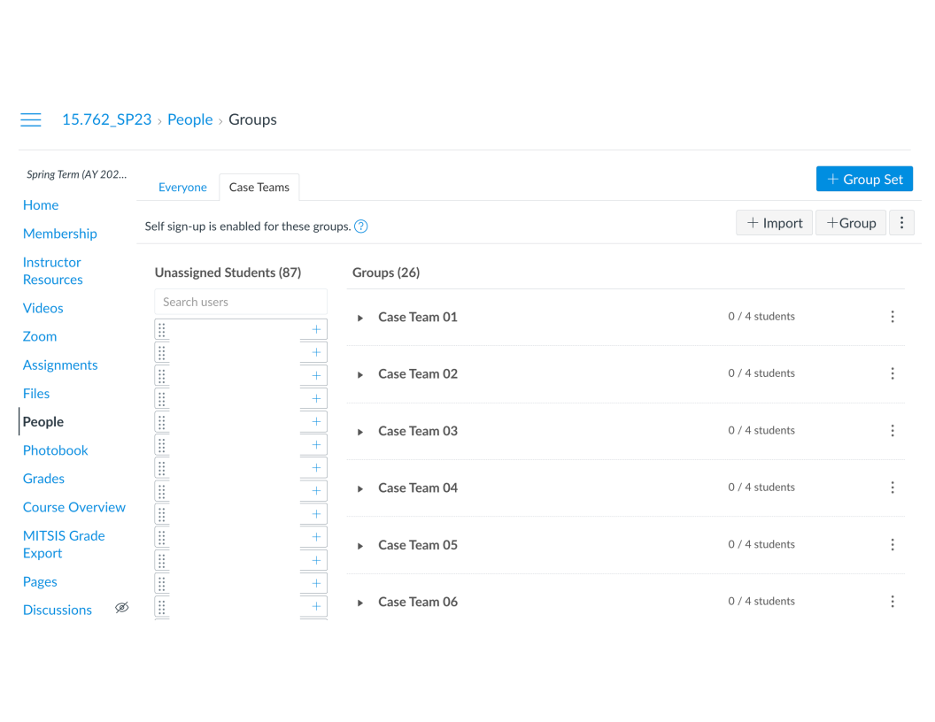
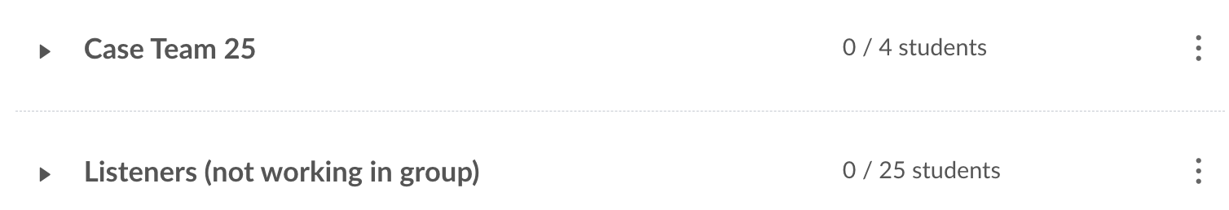
15.762 Class 02 – BioCo [Wednesday, 3/8]
If you have not joined a case team by Thursday at 5 p.m., we will assign you to a team

Slide 2
15.762 Class 02 – BioCo [Wednesday, 3/8]
If you have not joined a case team by Thursday at 5 p.m., we will assign you to a team
Highly-efficient teams can process a case in 3 hours
  Individual preparation for 1 hour in advance of meeting
  Team meeting for 1.5 hours to review calculations and make recommendations
  Individual completing assignment for 0.5 hours after meeting
Time is your most finite resource
  Always be thinking in terms of marginal benefit and marginal cost
  If MB < MC, stop
  If you are working on a case for more than five hours, reach out
3:1 Google sign-up sheet is: https://bit.ly/15762signup
Computers are allowed, if being used for in-class analysis

Slide 3


How I Think About Optimization
Total Cost [f(x)]
Actionable performance improvement
Theoretical performance improvement
Decision Variable [x]

Slide 4
Post Mortem With Positivity
If you ever finding yourself saying “I could do this better. I have a more optimal way. They are doing it wrong.” immediately pause and ask yourself
  Is the worker (that does this every day) really irrational? If not, then I have not fully described their situation
  I improve my model the most when I realize my model results do not align with the person’s actions; there must be a gap in understanding, and it is usually on my side
  People are not going to act against their interests and incentives
The current solution is almost surely at a locally optimal solution
  If it was obvious, everyone would do it
  Think of the most positive person you know, then be one standard deviation more positive
Capture your ideas in writing

Slide 6
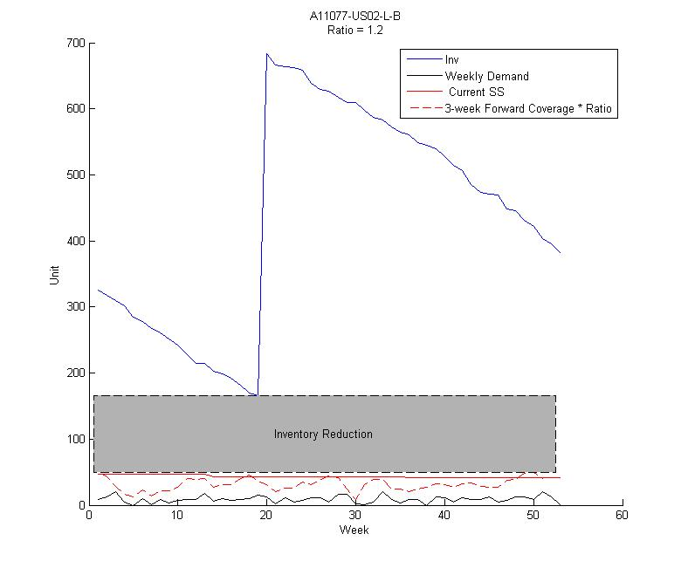
Identification of Safe Inventory Reductions
10k SKU-Locations
Filter built into decision support tools, with a fudge factor of 1.2
Help planners identify $3.4 million worth of actionable inventory (from a selection of $10 million inventory)

Slide 7
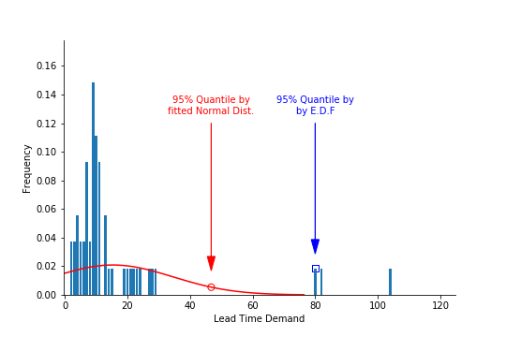
Don’t Approximate, Calculate Empirical Distribution Function
Identifying when lead time is non-negligible and i.i.d. normal distribution isn’t a good fit.

Slide 8
BioCo Summary
How do we want to work with observed demand?
  Map to some parametric (i.e., Normal) distribution
  Derive some nonparametric distribution
    Maximum demand over a horizon
      This is approach taken in BioCo, but not the only valid approach
    Empirical demand distribution (i.e., histogram, bootstrap)
      We will see these approaches later in term
Start by looking at what planners have done
Instead of trying to decipher the past, focus on the future
  Which SKUs could surely have inventory levels reduced?
  If minimum inventory on hand exceeds maximum demand over net replenishment time, that is good candidate for inventory reduction (sample path argument)

Slide 9
What Are We Optimizing?
All problems are solved with people, process, technology
As smart OR people, we often focus on the tool (i.e., technology), asking questions
  Is the model optimal?
  Have we implemented the model’s optimal solution
In limited settings, focusing on the tool is correct.
I think optimizing the process is the better decision
  Does the process produce a better result
  Will the process be accepted by the people?
  Is the process compatible with the company’s technology?
Examples:
  Excel versus Python, implementable versus lowest cost

Slide 11
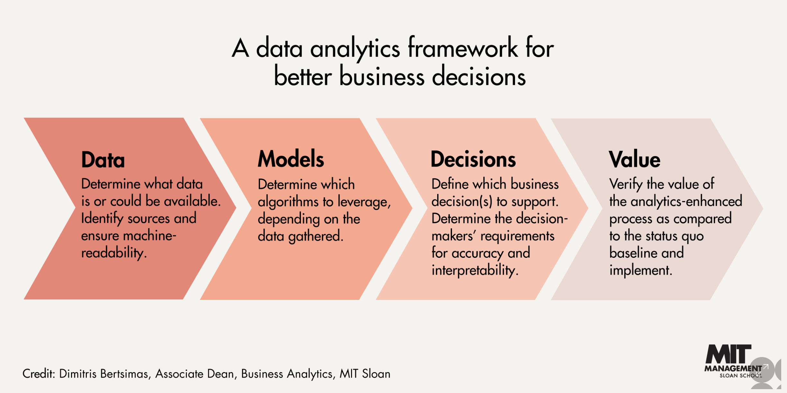
Lots Of Good Analytics Frameworks
https://mitsloan.mit.edu/ideas-made-to-matter/try-data-framework-analytics-advantage

Slide 12
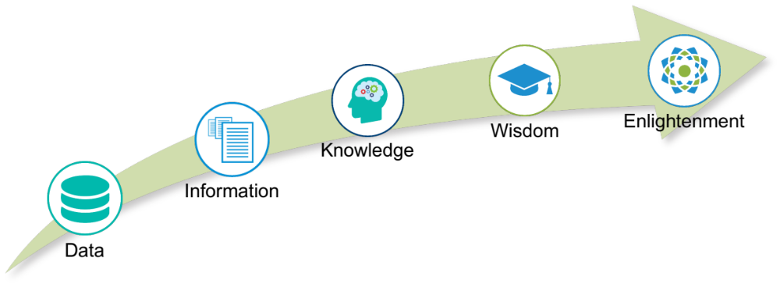
The Five Worlds of Analytics
Any analytics journey (i.e., project) must progress through five worlds
Each world requires specific skills to complete (boss challenge, intermediate challenge, cheat code)
Progression through worlds is not as linear as portrayed

Slide 13
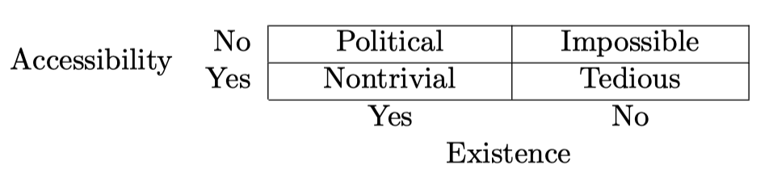
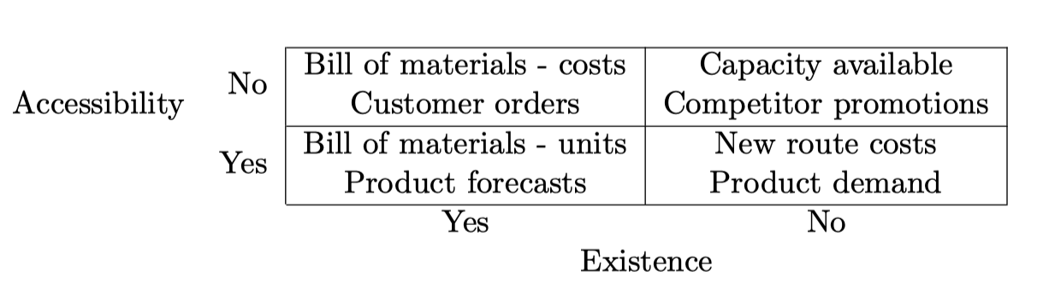
Data Dimensions – Accessibility and Existence
Data can be classified along two dimensions
Existence – is data in computer-readable format?
Accessibility – does analyst have access to the data?

Slide 14
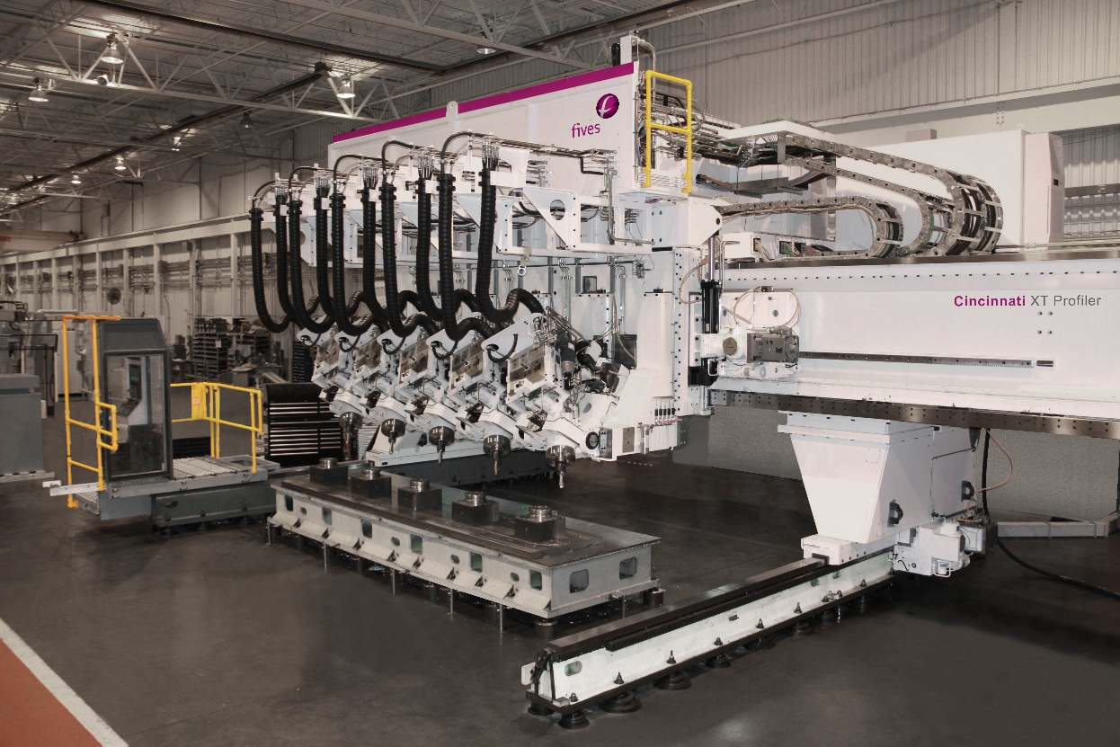
Creating Information From Data Is Often Hard
Two IoT-enabled machines at major defense manufacturer
  Machines are identical
  More than 1,000 IoT devices on each machine
  30 GB data stream
Machine 1
  1 is operational, 0 is idle
Machine 2
  1 is idle, 0 is operational

Slide 15
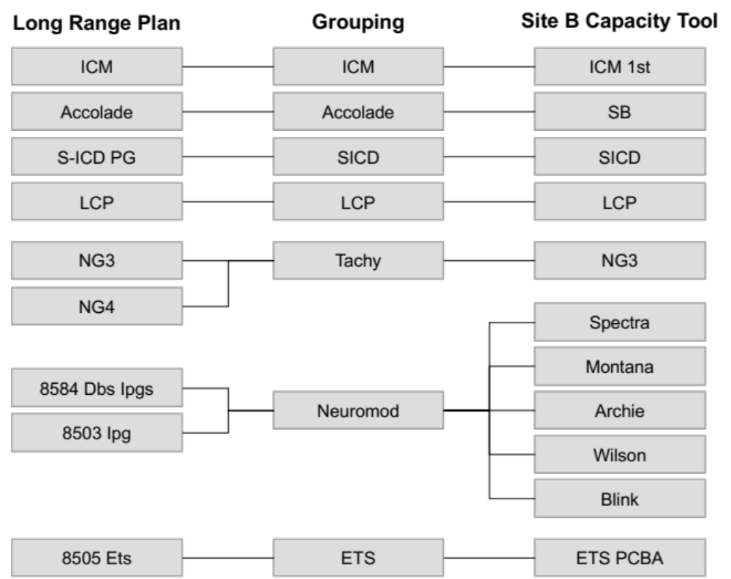
Data Is Still Not Easy (Really)
This example is from Simons, P. (2023)

Slide 16
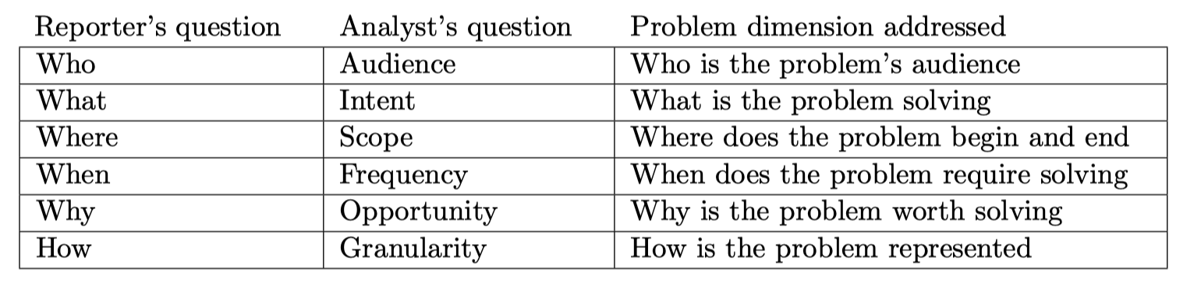
Information’s required skill = defining the problem
Common questions I get:
When do I know my model is good enough?
What should I model?
I used to answer: scope, granularity, intent (bounded scope
least granularity, focused intent)

Slide 17
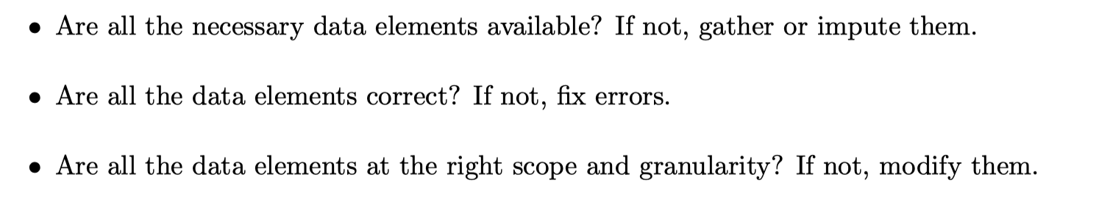
Creating Information From Data
Starting point is acquired data and answers to six questions
Then need to take following process steps:
I spent many hours trying to come up with something better
than this but this is best I could come up with.

Slide 18
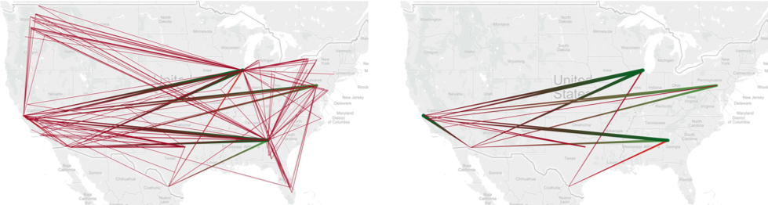
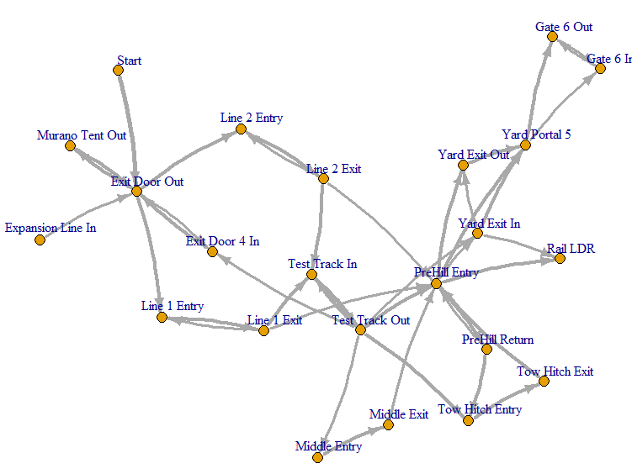
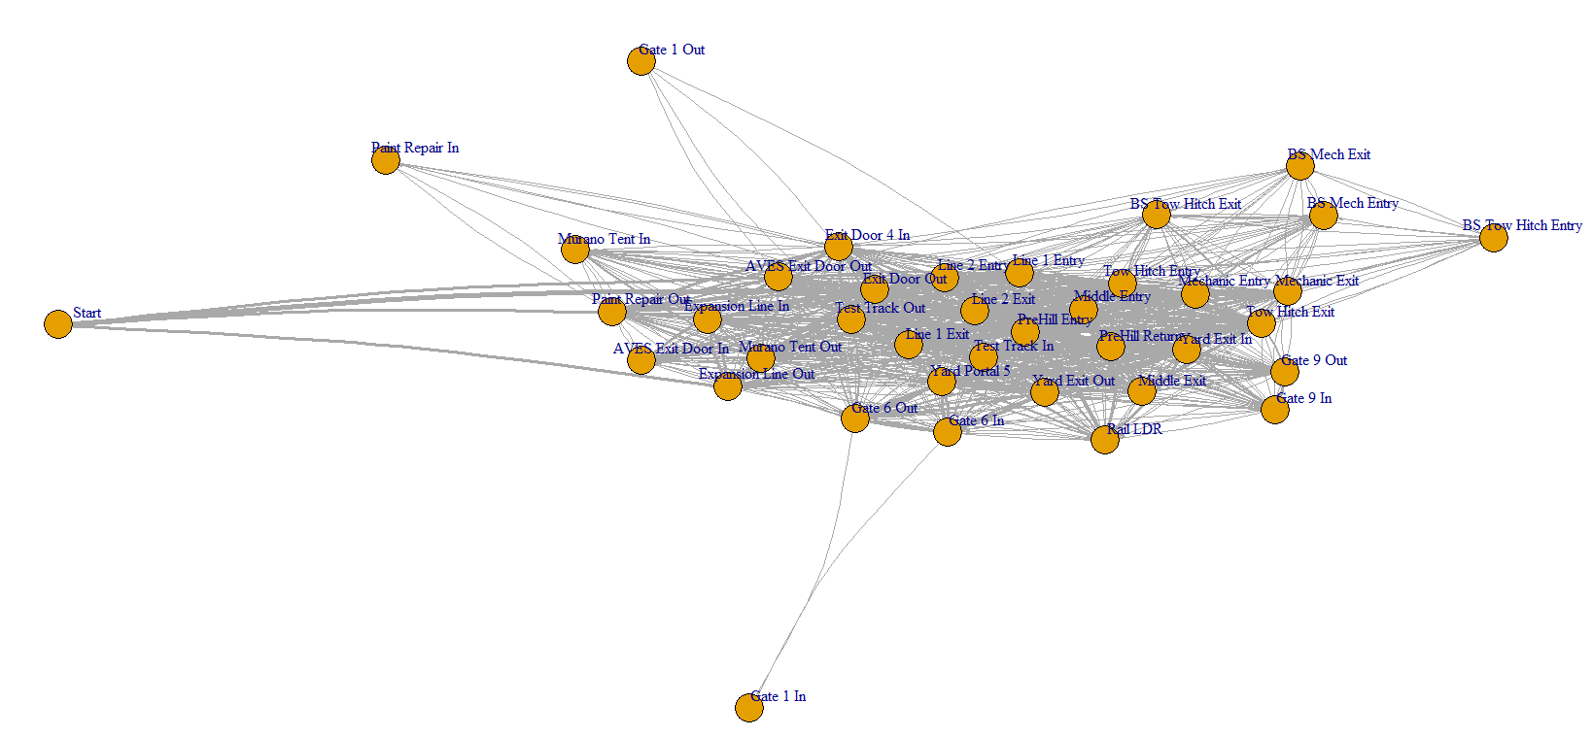
Information Processing Examples

Slide 19
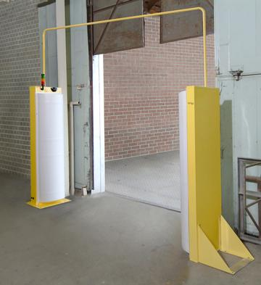
Open Question: Which World Fixes Errors? (Do we go back)
RFID scans at auto plant
  30% scans missing from database
  Median number of scans per vehicle ~10
  Maximum number of scans per vehicle exceeds 2,000
Geo-fence data for trucking company
  25% of stops have zero geo-fence data
  50% of stops are missing some geo-fence data
Do we ignore these realities? Do we fill in the blanks?

Slide 20
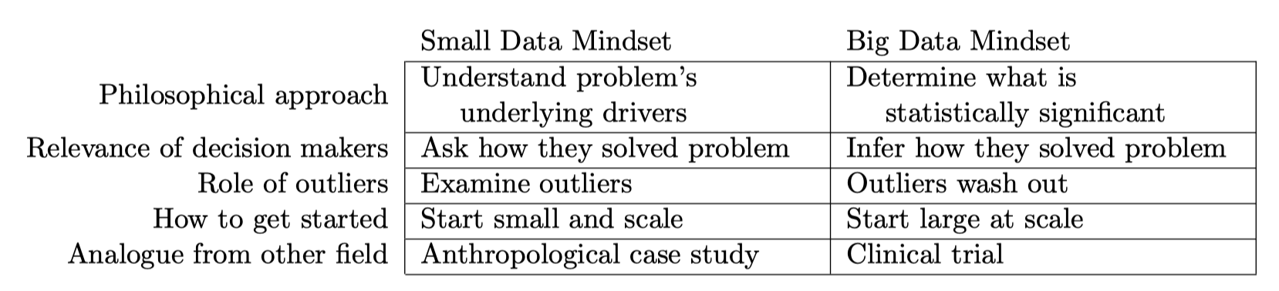
How Do You Attain Knowledge

Slide 21
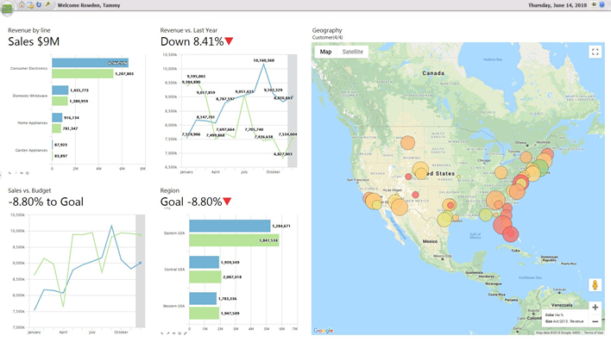
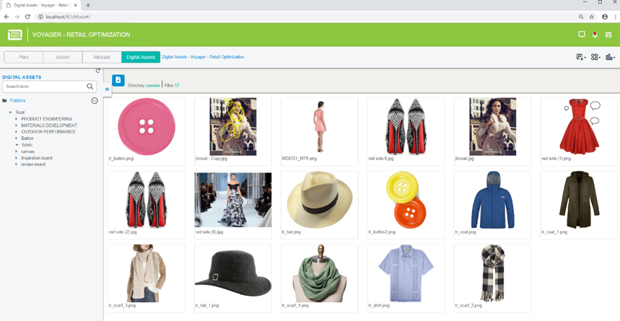
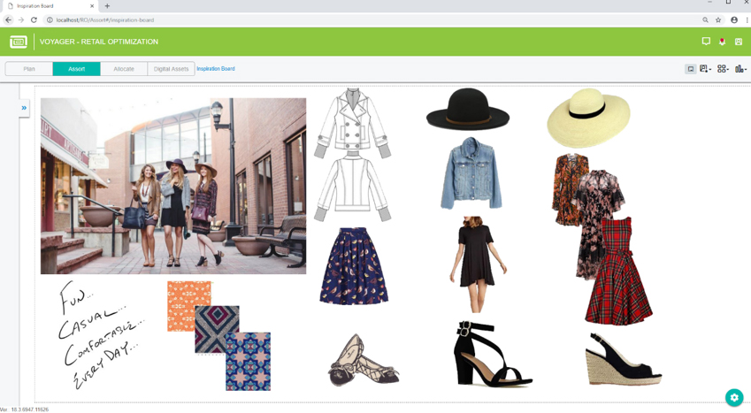
Sharing Wisdom With Others

Slide 22
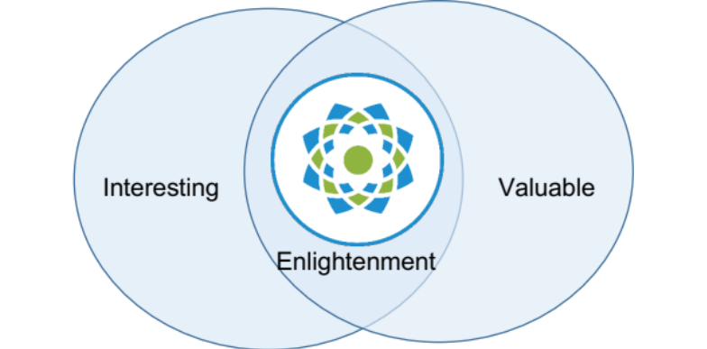
Attaining Enlightenment Going Forward
Frequency
Correctness
Benefit
Distilled to a Venn diagram

Slide 23
Five Stage Analytics Hierarchy
Required skill to complete world, boss challenge
Later thought about intermediate challenge, cheat code
I am not sure how strong linear-completion argument is

Slide 24
Simplify And Accelerate
Simplify and accelerate does not mean trivialize and rush
Do the math you can do, but recognize the math can’t solve everything, so there is a point where the math has to stop
Remind yourself of worst-case result from simplify and accelerate
  (1) Client understands model
  (2) You get to create a second model (even faster)
Why do simple building-block models apply in practice
  Very hard to beat naïve models, because they are unbiased
  Scientific models outperform heuristics

Slide 25
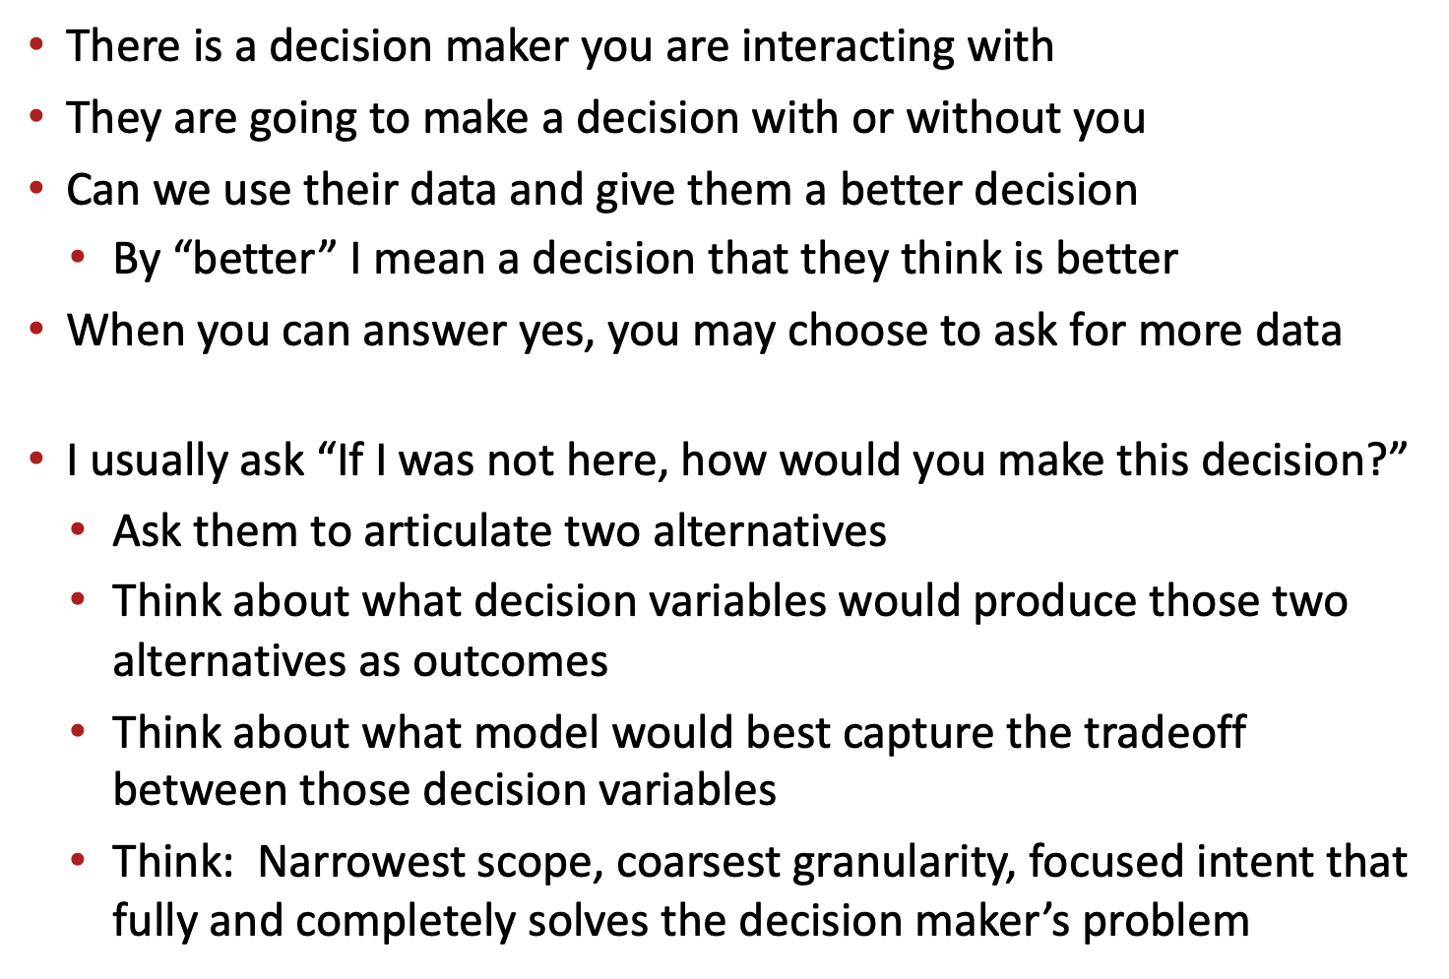
Process To Make Your Luck

Slide 26

Please complete the end-of-class two-question survey
What is your main learning?
What is your unanswered question?
https://bit.ly/15762LQ

